Slide 1

Fake News Detector Project
Using Machine Learning, Gemini AI, and Python GUI
Presented by: Muhammad Ismail, Nikhil, Sanaullah

Slide 2

Project Overview & IDea
project, the Fake News Detector, aims to automatically classify news headlines as either real or fake. By integrating traditional machine learning with advanced AI capabilities, we provide a robust solution for discerning journalistic integrity.

Slide 3
Tour to Project Output..
Then we will go to Backend of the Project

Slide 4
Data Preprocessing: Refining the Raw Text
Before any machine learning model can analyze text, it needs to be cleaned and structured. This crucial step ensures that our models receive consistent and meaningful input.
01
02
Remove useless columns & missing values
Convert Text to Lowercase
Removes useless or duplicate columns, so Ensures no empty rows go into training
"Trump" ≈ "trump" Reduces vocabulary size → better training
03
04
Clean the Text (Remove Special Characters)
Combine Title + Text and Remove Very Short Text
✔ Removes punctuation ✔ Removes numbers ✔ Removes emojis ✔ Keeps only alphabetic characters ✔ Collapses multiple spaces into one
Model learns from both title and full content
Texts smaller than 50 characters are removed:

Slide 5

ML Model 1: Logistic Regression
Our first machine learning model, Logistic Regression, serves as an efficient and interpretable baseline for text classification. It's renowned for its simplicity and effectiveness, making it an excellent starting point for our detection system.
probability = 1 / (1 + e^(–z))
z = (w1*x1) + (w2*x2) + (w3*x3) + ... + bias
X = [0.4, 0.1, 0.7]
W = [1.5, -0.3, 2.0]

Slide 6
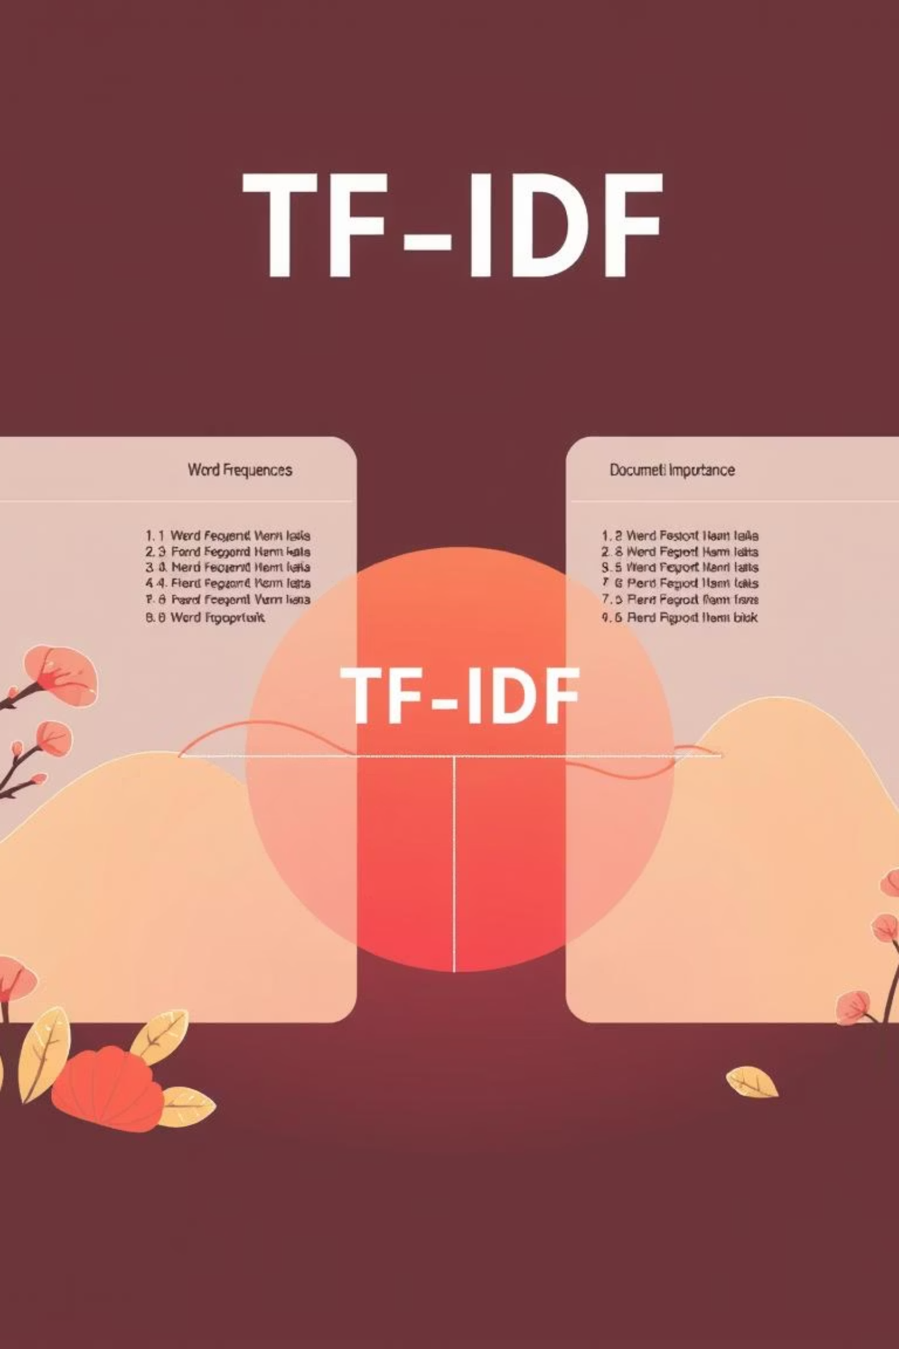


TF-IDF: Quantifying Word Importance
TF-IDF
TF (Term Frequency)
how many times a word appears.
IDF= (Inverse Document Frequency).
how rare the word is in all documents
Analysis the data:
For News
Govt 1 log(2/1)= 0.30
Policy 1 log(2/2)= 0
Fake 1 log(2/1)=0.30
Real News: (0.30, 0)
Fake news : (0, 0.30)
Convert text into numbers so ML can understand it
REAL NEWS:
Govt launches new policy
FAKE NEWS:
Fake rumor spread about policy.

Slide 7

Support Vector Machine (SVM)
SVM is a classification algorithm that separates data into categories by drawing the best possible dividing line
Effective in High Dimensions: SVM is good at handling the text, because text has many features.
Optimal Decision Boundary: Identifies the best hyperplane to separate real from fake news with the largest margin.
Proven Accuracy: SVM gives high accuracy in many text classification tasks, including fake news detection.

Slide 8



Gemini AI Integration: The Reasoning Layer
Used only for articles predicted fake by ML
When is Gemini used?
Only when the ML model (SVM) says:
This news might be fake.
🤖 What Gemini does:
Searches facts
Compares claims
Analyzes sources
Gives an explanation

Slide 9

Random Forest
Random Forest is a machine learning algorithm that
builds many decision trees,
each tree gives its own prediction,
then the forest votes for the final answer
>make a stronger and more accurate prediction

Slide 10

Intuitive GUI with Tkinter
Our user-friendly graphical interface, built with Python's Tkinter, makes the Fake News Detector accessible to everyone.
Input Headline
Instant Detection
Users simply type or paste a news headline into the designated text field.
A single click of the "Detect" button initiates the analysis process.

Slide 11
The Future of News Verification
Our Fake News Detector showcases the power of combining traditional machine learning with advanced AI for more reliable information assessment.
1
2
Combined Strength
User Empowerment
The system smoothly uses both ML and Gemini AI together to make predictions better and give more understanding.
It helps users easily check if a news headline is real or fake and avoid misinformation.

Slide 12

Examples to Try!
Lena Cervin withdraws controversial plan on social security reform in Northbridge
In Southgate, Tomas Belmont, a member of the Conservative Front, endorses a proposal aimed at climate regulation affecting communities across the Southern Shore. The measure, described by supporters as controversial, would allocate new funding and change existing regulations to address long-standing concerns. Opponents argue the plan may have unintended consequences and call for further study and public hearings before any action is taken.
News
12-Jun-18
Fake
Nova Dunmore blocks symbolic
plan on veterans benefits reform in the Western District
In Riverton, Alden Graft, a member of the New Unity Party, withdraws a proposal aimed at education funding affecting communities across Midland District. The measure, described by supporters as symbolic, would allocate new funding and change existing regulations to address long-standing concerns. Opponents argue the plan may have unintended consequences and call for further study and public hearings before any action is taken. Analysts say the proposal is unlikely to pass before the end of the current legislative session.
politicsNews
20-sept-21
Fake
Senator McConnell demands immediate action on Supreme Court nominee impasse
WASHINGTON D.C. - Senate Majority Leader Mitch McConnell today delivered a fiery speech from the Senate floor, pressuring Democrats to allow a vote on the President's latest Supreme Court nomination. McConnell stated that the current political impasse is damaging to the integrity of the judicial branch and that the Senate must fulfill its constitutional duty. Minority leaders responded by calling for a more moderate nominee and arguing the current selection is too divisive.
politicsNews
05-mar-17
Real

